Slide 1

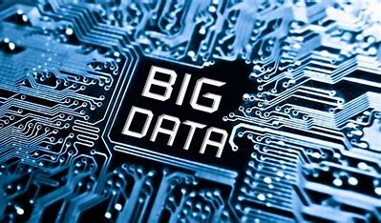
Laxmi Devi Institute of Engineering And Technology
BIG DATA
Created by - Aashish Kumar Saini
B.tech. Sem 3rd C.S.E.
Session 2022-23
Submitted To – MR. Atul Gaur, MR. Anil Rao

Slide 2
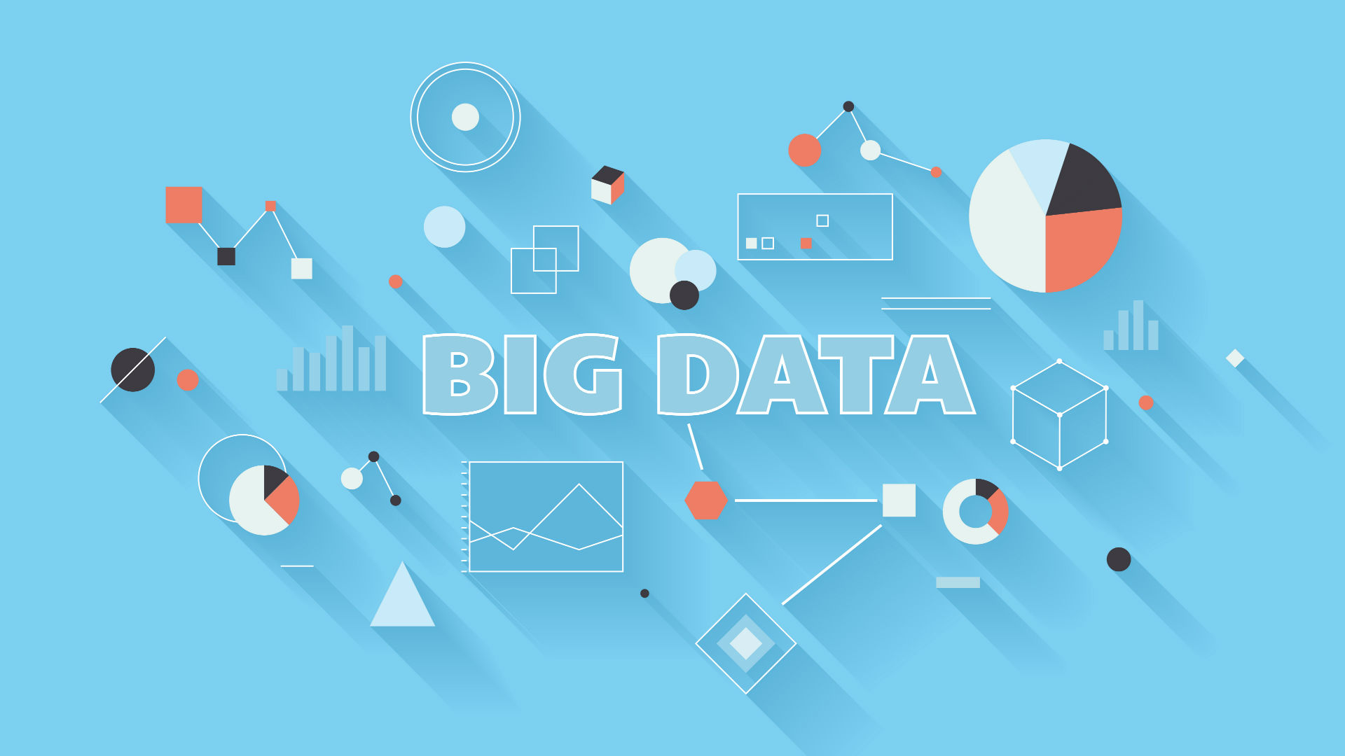
This Photo by Unknown Author is licensed under CC BY-SA-NC

Slide 3
CONTENTS
Introduction
What is Big Data
Characteristics of big Data
Need of Big Data
Big Data Analytics
Data Generation Points Examples
Tools for Big Data Analytics
Applications
Advantages
Disadvantages

Slide 4
Introduction
Big data refers to the massive volume of structured and unstructured data generated by various sources such as machines, sensors, social media, and more.
This data is to large and complex to be processed using traditional data processing methods.
Big data technologies enable organizations to collect, store, process, and analyze the information to improve the decision making and innovative solutions across various industries

Slide 5
What is Big Data?
Data which are very large in size is called Big Data.
Normally we work on data of size MB(Word, Excel) or maximum GB(Movies, Codes) but data in Peta bytes i.e. 10¹⁵ byte size is called Big Data.
Big data is a collection of data that Is huge in volume, yet growing exponentially with time.
It is a data with so large size and complexity that none of traditional data management tools can store it or process it .

Slide 6
Characteristics of Big Data
Big Data
Volume
Velocity
Variety

Slide 7
1. Volume
Volume refers to the size of the data generated and collected.
Big data involves datasets that are beyond the capacity of traditional databases and tools to manage.
This massive volume of data includes structured, unstructured data form various sources such as sensors, social media, etc.
2. Velocity
Velocity related to the speed at which data is generated, collected, and processed.
In Big Data velocity data flows in from sources like machines, networks, social media, mobile phones etc.
Example: There are more than 3.5 billion searches per day made on Google. Also, Facebook users are increasing by 22% (approx.) year by year.
3. Variety
It refers to nature of data that is structured, semi-structured and unstructured and unstructured data.
It also refers to heterogeneous sources.
The challenge lied in integrating, managing, and analyzing this heterogeneous mix of data formats effectively.

Slide 8
Why Big Data is needed ?
Increase of storage capacities.
Increase of processing power .
Availability of different types of data.
Every day we create 2.5 quintillion bytes ( two and half of billion gigabytes) of data.
IBM claims 90% of the today’s stored data was generated in just the last two years.
Facebook generates 10TB data daily.
Twitter generates 7TB of data daily.

Slide 9
Big data Analytics
This analytical approach involves using various techniques, tools, and technologies to make sense of the massive volume of data generated from diverse sources like social media ,devices, etc.
Identification of hidden patterns, unknown correlations .
Competitive advantage.
Effective marketing, customer satisfaction, increased revenue.

Slide 10
Data Generation Points Examples
Mobile Devices
Social Media
Microphones
Readers/Scanners
Science facilities
Programs/software
Cameras

Slide 11
tools for Big Data analytics
Apache Hadoop
Apache Spark
Apache Storm
MongoDB
Kafka
RapidMiner
R Programming

Slide 12
Application of Big Data Analytics
Smarter Healthcare
Telecommunication
Traffic Control
Manufacturing
Search Quality
Trading Analytics

Slide 13
Advantages of Big Data analytics
Better decision making
Reduce costs of business process
Increased productivity
Improved customer services
Increased agility

Slide 14
Disadvantages of Big Data analytics
Security risks
Compliance
High cost
Complexity
Technical challenges and requirements

Slide 15
Sources
ChatGPT
JavaTpoint
Geeksforgeeks
Guru99
Slide share
Data Flair
Towards AI

Slide 16
Thank You

